Slide 1
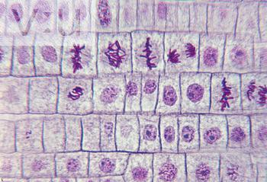
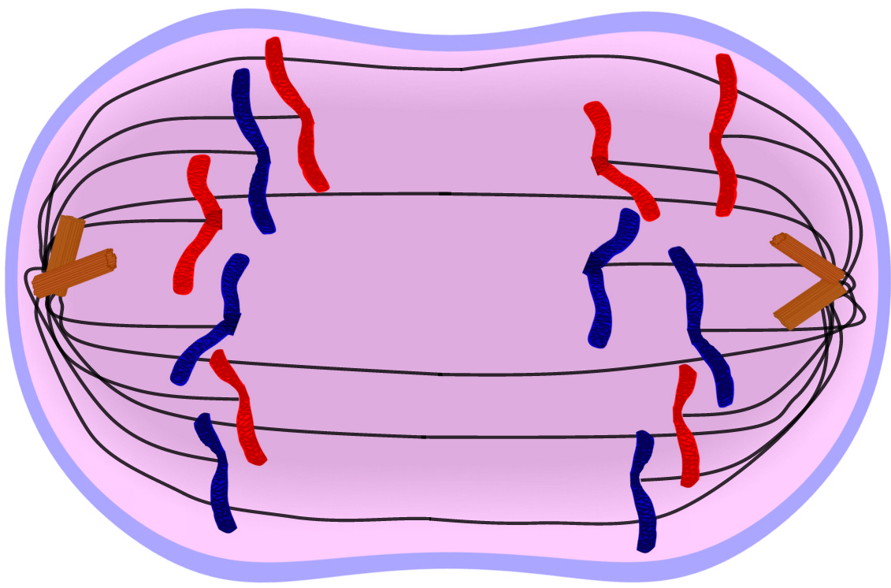
Mitosis
Doing a Double Take
Sixth Grade Life Science presentation for Mr. Carlin’s Flipped Classroom

Slide 2
Mitosis – The process of cell division
Cells go through steps when they divide
The steps are called phases
The time between division can be as short as 20 minutes or as long as several years
Cells divide when the organism needs to grow
Cells divide to replace damaged or dead cells

Slide 3
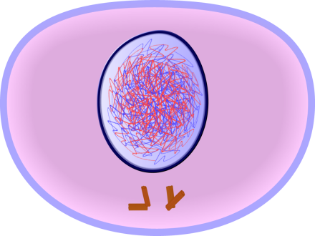
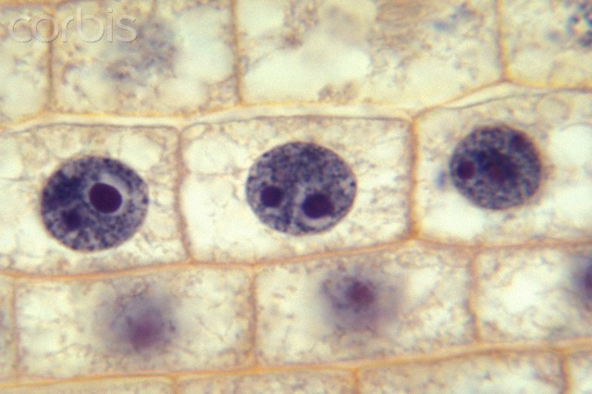
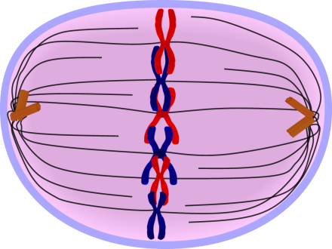
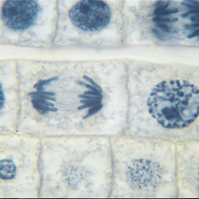
Mitosis – The process of cell division
Animal Cell
Plant Cell
Cell membrane
Cell wall
Nucleus
Nuclear membrane
Spindles
Chromosomes

Slide 4

Mitosis – The process of cell division
Interphase
  Often called the stage of rest, but this is actually when the cell does all its work
  The chromosomes have unraveled and are not visible
Drawing of cell in interphase
Onion cell in interphase

Slide 5
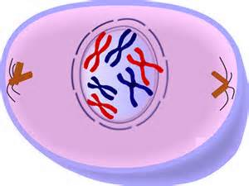
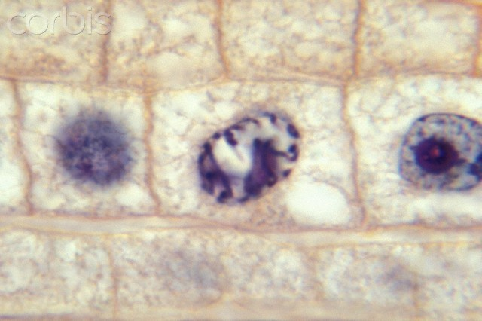
Mitosis – The process of cell division
Prophase
  The chromosomes have coiled up and are visible, but scattered
  The nucleus membrane has dissolved
Drawing of cell in prophase
Onion cell in prophase

Slide 6
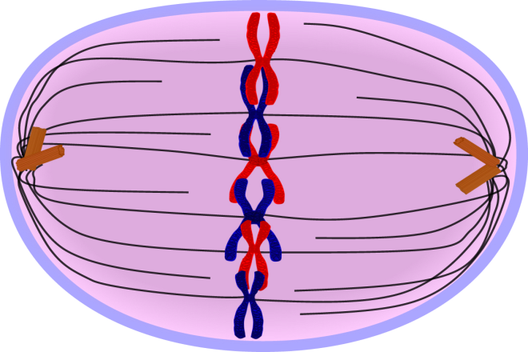
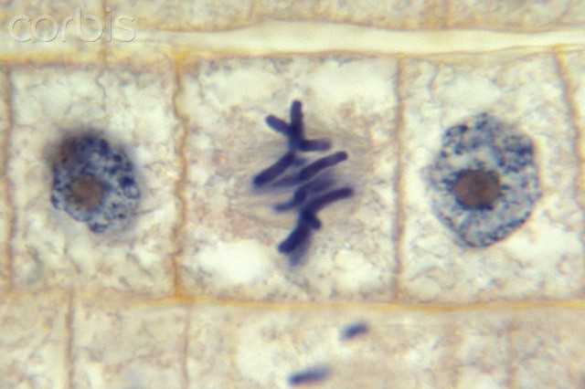
Mitosis – The process of cell division
Metaphase
  Chromosomes have aligned in the middle of the cell
  Spindles have moved to opposite ends of the cell
Drawing of cell in metaphase
Onion cell in metaphase

Slide 7
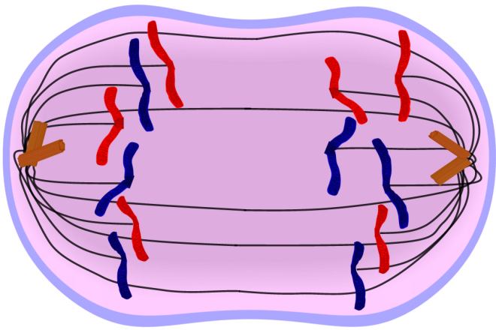
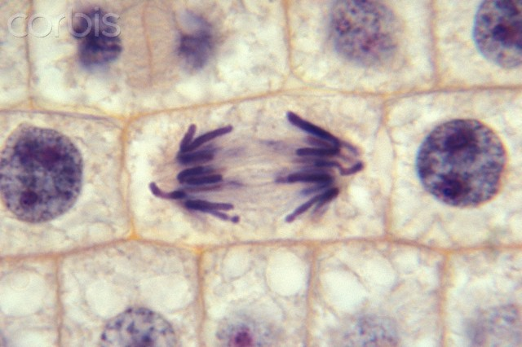
Mitosis – The process of cell division
Anaphase
  Spindles pull half of the chromosomes to opposite ends of the cell
  New cell plate starts to form between the daughter cells
Drawing of cell in anaphase
Onion cell in anaphase

Slide 8
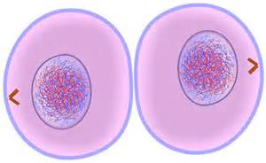
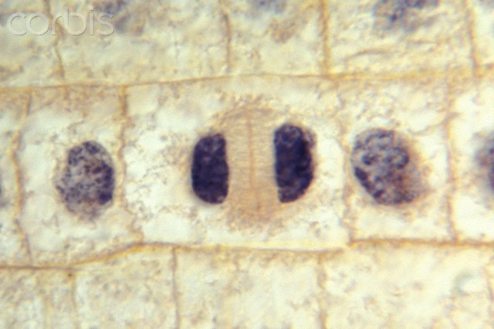
Mitosis – The process of cell division
Telophase
  Cell plate forms between the new daughter cells
  Chromosomes begin to unravel
Drawing of cell in telophase
Onion cell in telophase

Slide 9
Mitosis – The process of cell division
Mitosis Quiz
Which phase of mitosis is shown here (click on the term on the left)
Interphase
Prophase
Metaphase
Anaphase
Telophase

Slide 10
Mitosis – The process of cell division
Mitosis Quiz
Way to GO!
Click here

Slide 11
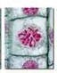
Mitosis – The process of cell division
Mitosis Quiz
Which phase of mitosis is shown here (click on the term on the left)
Interphase
Prophase
Metaphase
Anaphase
Telophase

Slide 12
Mitosis – The process of cell division
Mitosis Quiz
Way to GO!
Click here

Slide 13
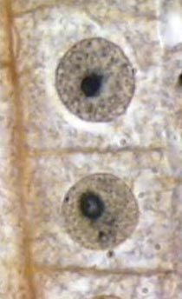
Mitosis – The process of cell division
Mitosis Quiz
Which phase of mitosis is shown here (click on the term on the left)
Interphase
Prophase
Metaphase
Anaphase
Telophase

Slide 14
Mitosis – The process of cell division
Mitosis Quiz
Way to GO!
Click here

Slide 15
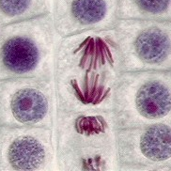
Mitosis – The process of cell division
Mitosis Quiz
Which phase of mitosis is shown here (click on the term on the left)
Interphase
Prophase
Metaphase
Anaphase
Telophase

Slide 16
Mitosis – The process of cell division
Mitosis Quiz
Way to GO!
Click here

Slide 17
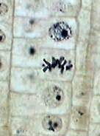
Mitosis – The process of cell division
Mitosis Quiz
Which phase of mitosis is shown here (click on the term on the left)
Interphase
Prophase
Metaphase
Anaphase
Telophase

Slide 18
Mitosis – The process of cell division
Congratulations!
You know the phases of mitosis!
Click here

Slide 19
Mitosis – The process of cell division
Mitosis Quiz
Sorry, try again
Click here

